Slide 1
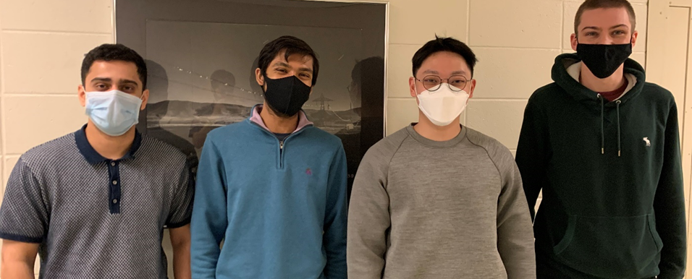
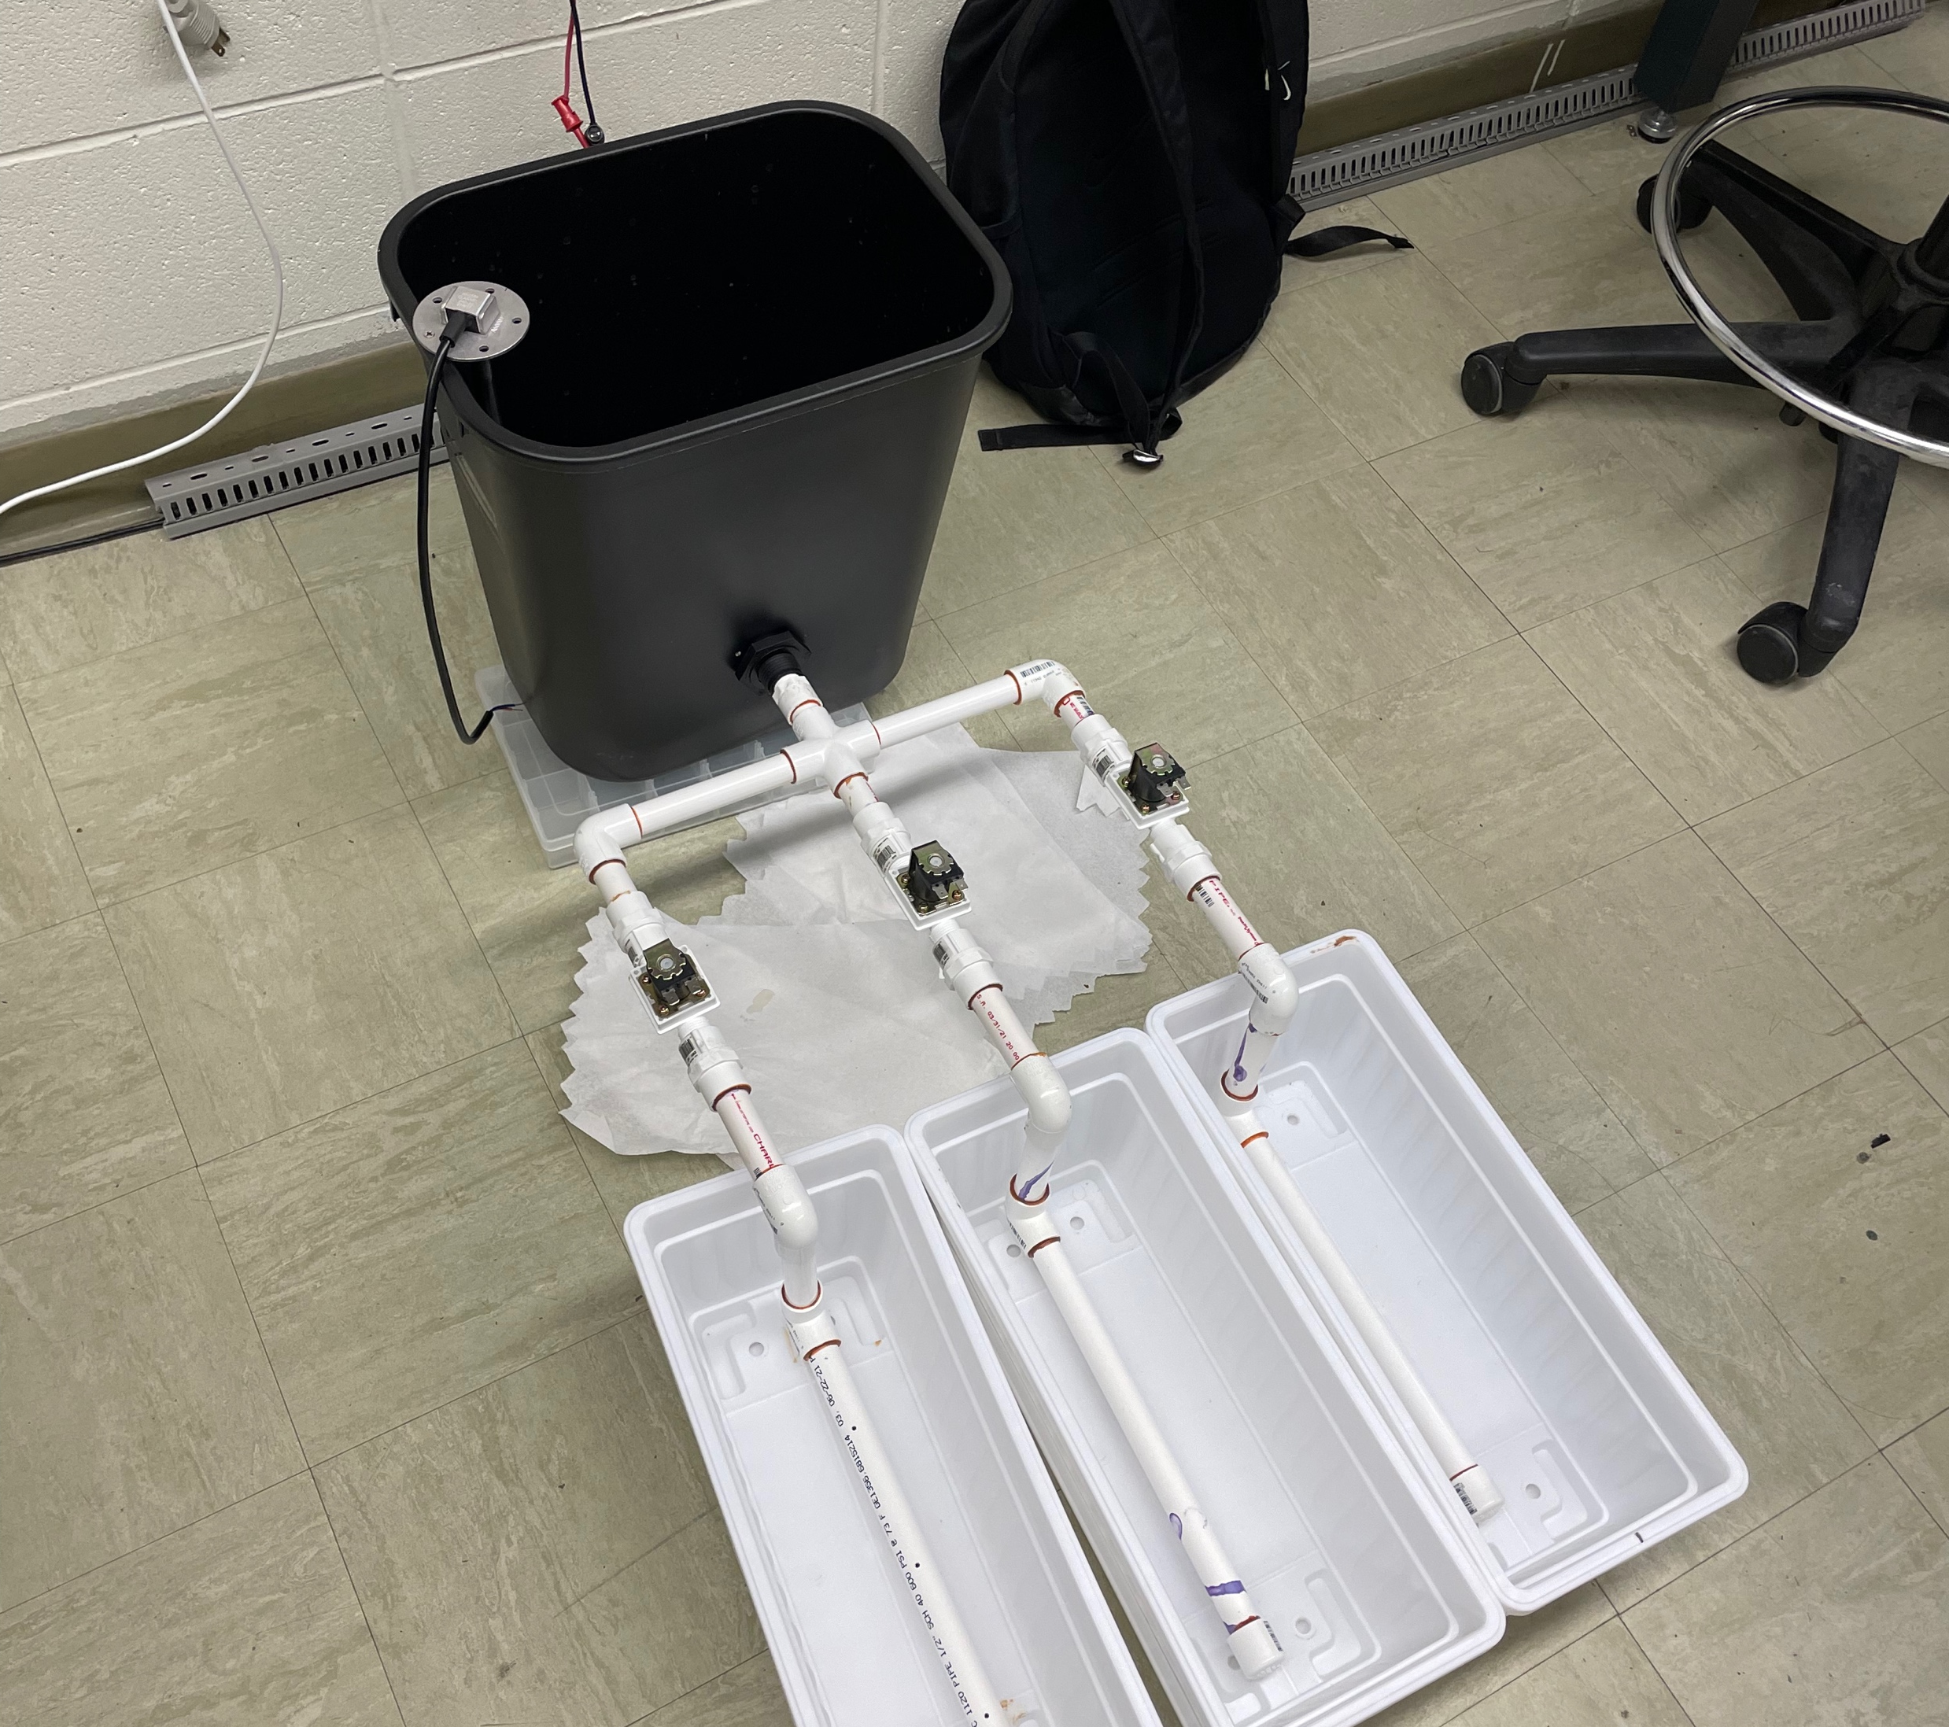
Team 22: The Lazy Gardeners
Vraj Parmar, Tanaykumar Murarka, Seungbong Shin, Chase Wikberg
Team 22's Senior Design Project was focused on the creation of an Automated Gardening System. We wanted the system to allow for home gardeners to more easily and efficiently take care of several plants either for hobby gardening or small-scale home agriculture. The device can detect various local conditions, the amount of water in the reservoir used to water the plants, the amount of moisture in the soil of each individual planter, and the number of dissolved solids in the reservoir water and output each of those values to the user on their laptop via a USB connection. The device can then take that data and use it to open valves connecting the planters to the reservoir via PVC and automatically water the plants, also notifying the user as it does so, if there is enough water to properly fill the reservoir. This only requires one external connection with a wall outlet providing all needed power to perform the above functions, and the USB being used only to communicate to the user.

